Slide 1
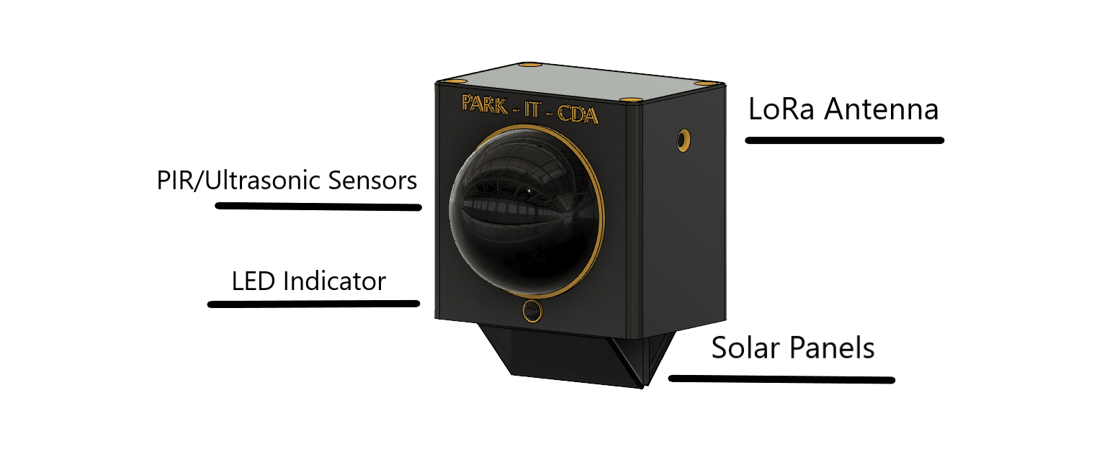
Park-it-CDA
Garage Sensor System over a Mesh Network
Notes:
1

Slide 2
Team
Nikolai – Computer Science
Team Leader
Mesh Network
Tyrel – Computer Science
Simulation
Database
Zane – Computer Science
Unit design
Sensor prototyping
Joel – Computer Science
Encryption
Wiki Site
Sponsor
Dr John Shovic
Switchdoc Labs
Instructor
Dr Rick Sheldon
Mentor
Dr Bob Rinker
Notes:
2

Slide 3
Project Objective
There is a new parking Garage that opened near the Innovation Den in Coeur d’Alene
We are to create 5 prototype units that will be placed above the entrance and exit of the garage and 3 parking locations of our choice
These Garage Sensor Units (GSU) will form a Garage Sensor System (GSS) that communicate with one another via a wireless technology
One of the GSU will be a Garage Sensor Master (GSM) that will be responsible for sending information to the Garage Sensor Gateway (GSG) located on the roof of the Den
They are to sense a blockage – a car, in a parking spot and relay the information to the Den
This information will be used to simulate the entire parking garage

Slide 4
Value Proposition
Too much time and effort are spent by those looking for a place to park in one or more garages in downtown Coeur d’ Alene
Commuters would benefit greatly from a system that indicates whether there are spaces available for parking within a parking garage
The GSS will allow people to find open parking spaces, and provide this information to them before they enter the garage
A companion app may be added to provide information as well
Notes:
4

Slide 5
Background
Notes:
5

Slide 6
Requirements – Parking Sensor - Zane
Notes:
6

Slide 7
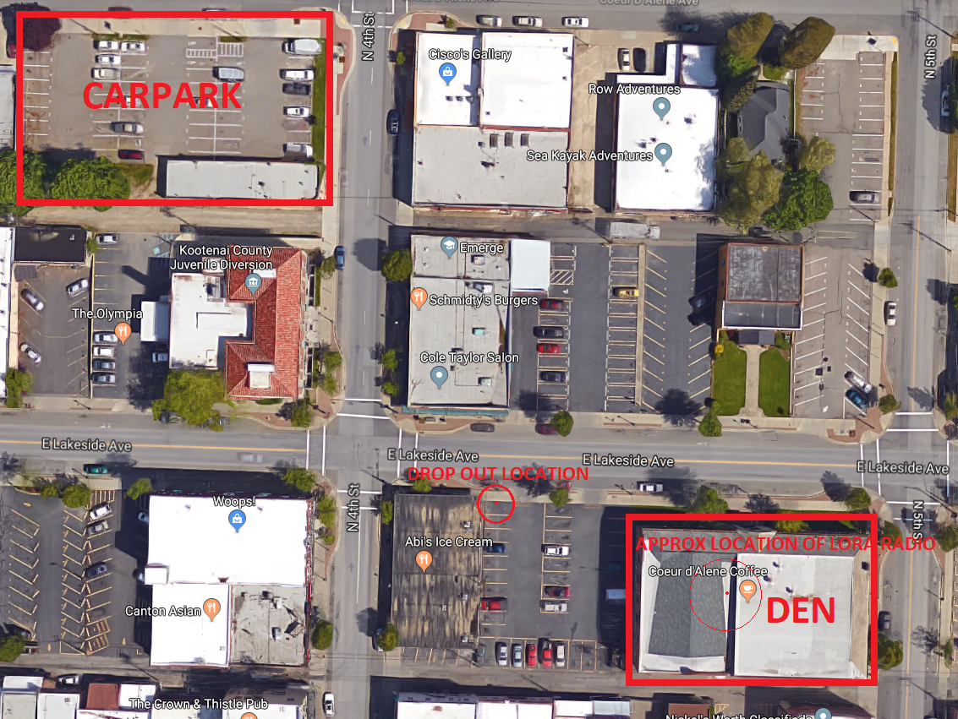
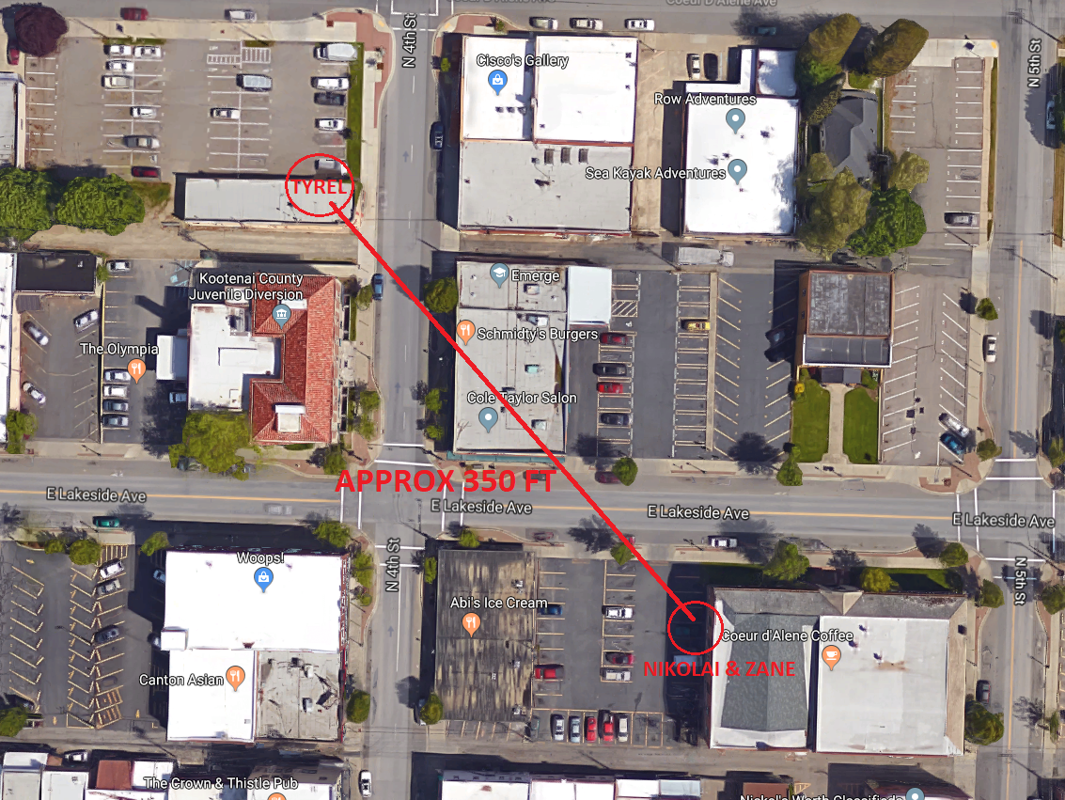
Networking
Create a dynamic mesh network out of the 5 prototypes that will be able to communicate with one another and change which will be the one sending a message back to the Innovation Den
Lowered in scope to have a fixed GSM which all the other GSUs will communicate with. The GSM is then responsible for forwarding onto the GSG at the Innovation Den
Researched and decided upon LoRa for its low power usage and capability of long-range transmissions
Our testing revealed that we will be able to make the distance between the parking garage and the Innovation Den approx. 350 ft apart.
Notes:
7

Slide 8
Battery Life
Requirement is to have every GSU in the parking garage last a full year without recharge
2 challenges posed here – Minimizing battery usage and procuring a large enough battery
Reducing battery usage involved selecting an Arduino based device and reduce power usage by putting it to sleep
Obtaining a battery from a reputable vendor proved to be a large time sink – ideal battery size ~20,000 mAh
Requirement changed to obtain a smaller battery
Solar power was also something considered – use ambient light and a solar charger to provide a trickle charge

Slide 9
Encryption - Joel
Test
Notes:
9

Slide 10
Simulation - Tyrel
Test
Notes:
10

Slide 11
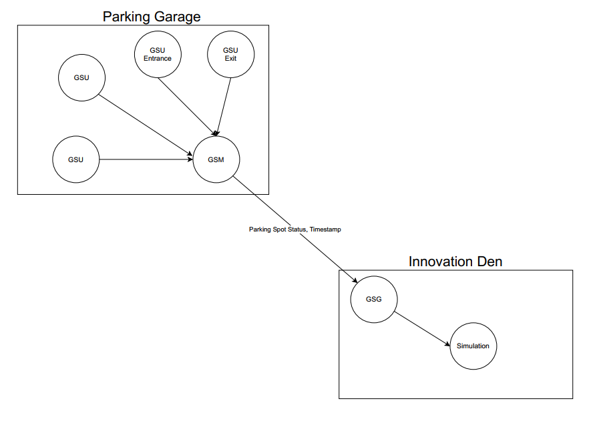
“Final” Design
Notes:
11

Slide 12
New Requirements and Design – Post COVID-19
Due to COVID-19, all our plans to integrate the system were thrown out the window: Social-distancing, building and business closures
The parking garage itself was now almost completely empty
We had all the components but couldn’t integrate it
Meeting with our Sponsor gave us the following goal: do whatever we can to get the GSS to work with what we have. Remove requirements that can’t be met or are no longer relevant such as the battery
Notes:
12

Slide 13
Introducing the ZSS – Zane Sensor System
Given that we were mostly confined to our homes we had to work out a way to implement the GSS in a way that is like the original design.
Since Zane was working on the sensors, his home will take the place of the parking garage and the GSU
Nikolai would then act as the GSM and GSG between the parking garage and Den
Tyrel would act as the server in the Den
We would use the internet instead of a local network for the connection between the GSG and the server
Notes:
13

Slide 14
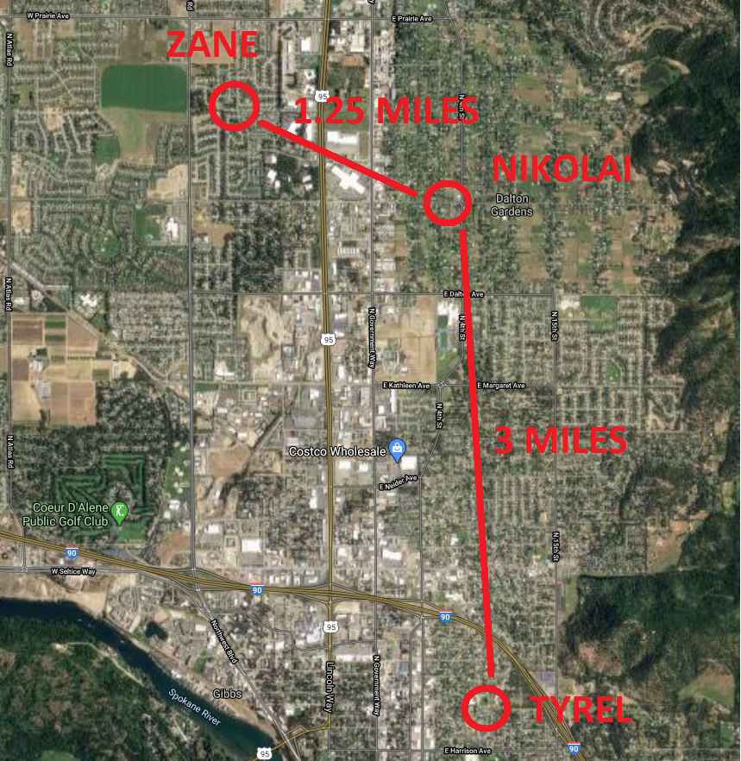
New Networking Problem - Range
Notes:
14

Slide 15
New Networking Problem - Range
LoRa is capable of very long ranges – 100’s of Km in perfect conditions with Line of Sight and large antennas, neither of which we had
The average distance for our GSUs to the GSG at the Innovation Den is ~400 ft
The next closest person to Zane was Nikolai at ~1.25 Miles away
1.25 Miles = 6600 ft => 16.5x longer range than our first range test
A shopping mall lies in between our paths
Notes:
15

Slide 16
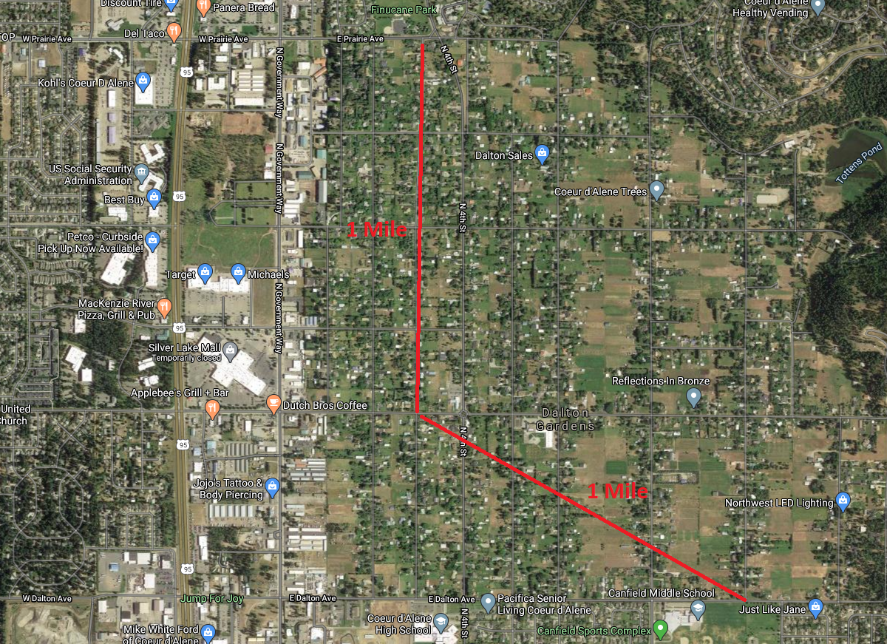
New Networking Problem - Range
Obtained +10 dBi Yagi antennas from our Sponsor
Zane and Nikolai did some range testing around the neighborhood to see how far our GSU could reach
We reached 1 Mile before the signal dropped out – 80% of the way

Slide 17
New Networking Problem - Range
We had a couple options at this point – try and buy larger antennas online, but they would likely arrive too late
Get the antennas as high as possible by building a mast
Note: we are not civil or mechanical engineers and the following does not follow any kind of rigor or procedures

Slide 18
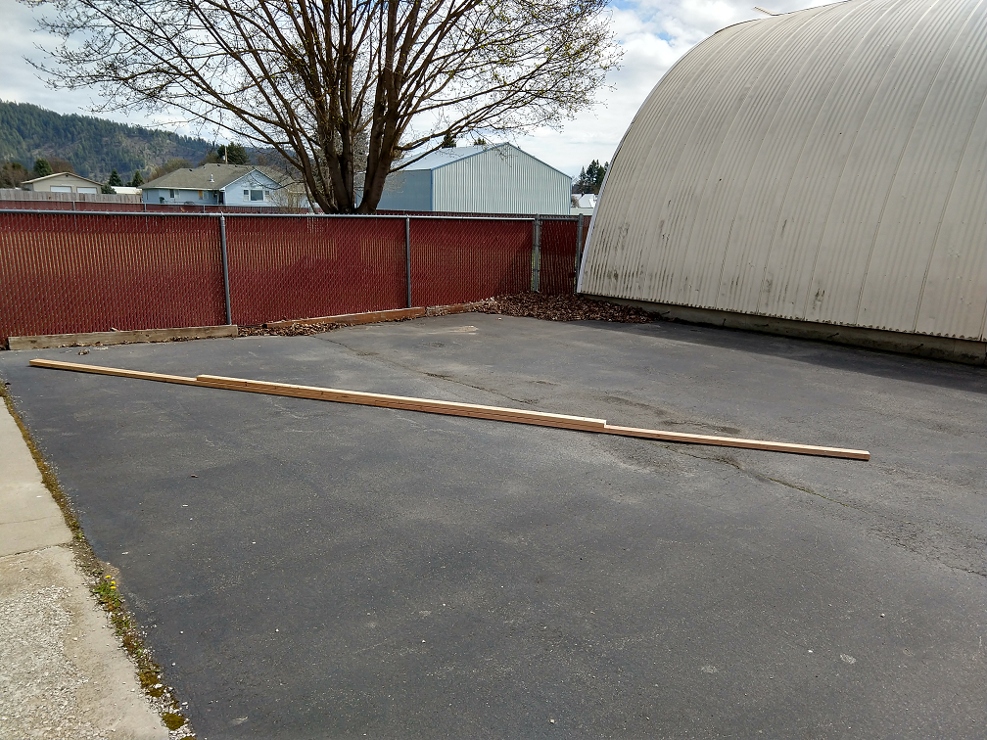
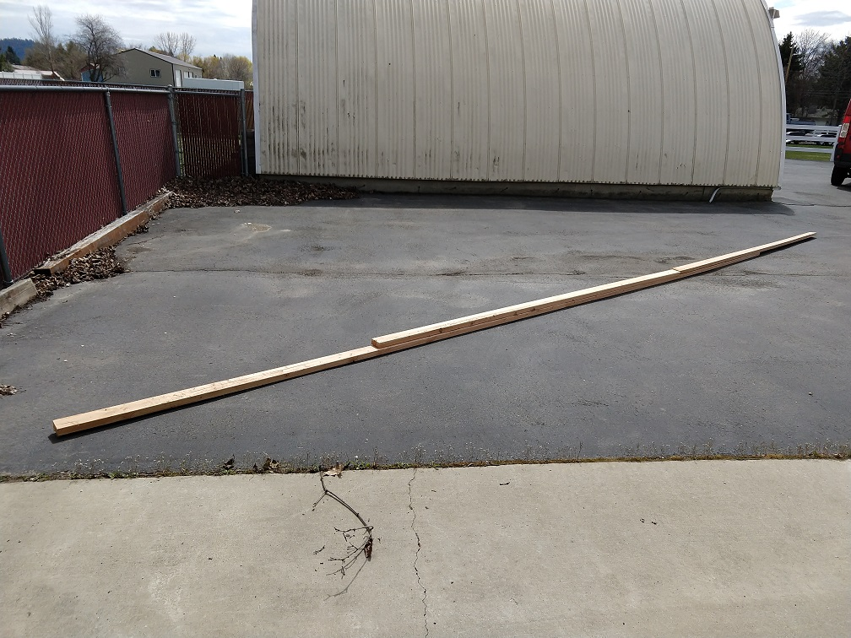
New Networking Problem – Antenna Mast
Possible options
2x4x12’s stacked together to make 24 ft or 30 ft
Weighs 60-80+ lbs and don’t have anywhere to mount it safely without digging a hole and using concrete

Slide 19
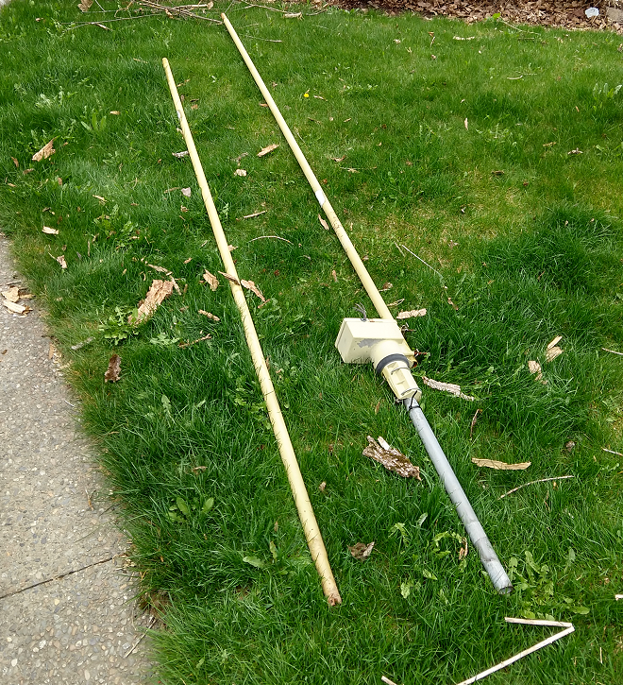
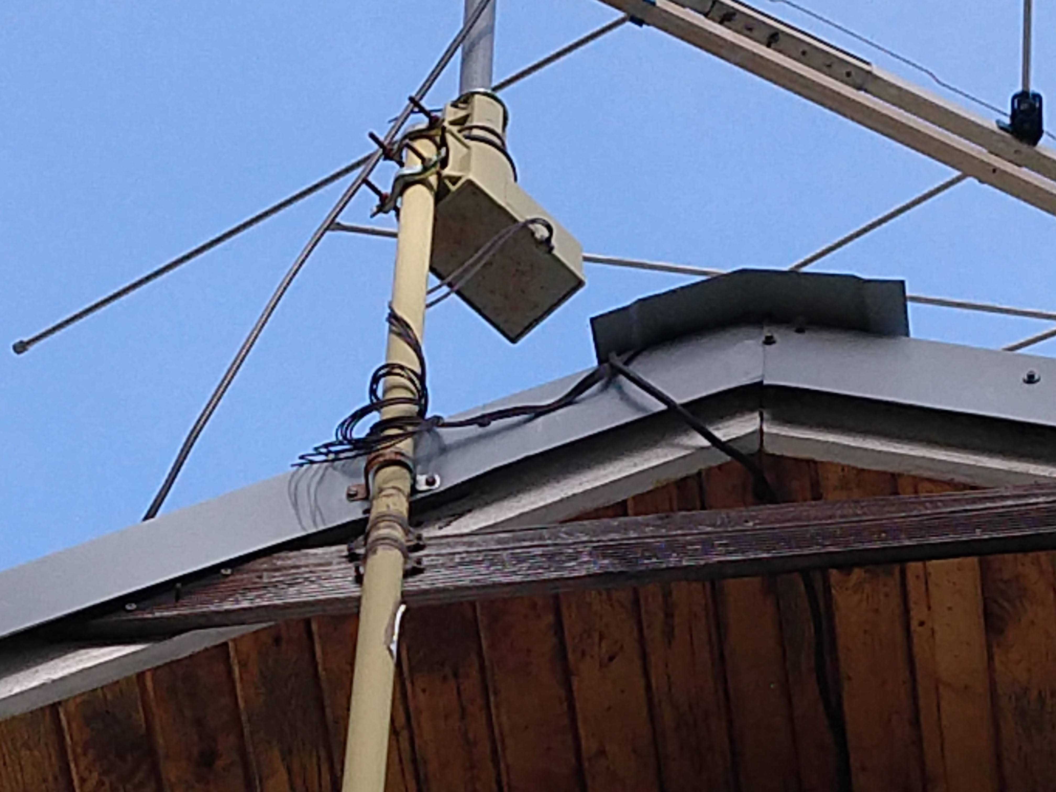
New Networking Problem – Antenna Mast
Nikolai was able to obtain an old 20 ft TV antenna mast mounted to a house. Just had to climb onto the roof and take it down

Slide 20
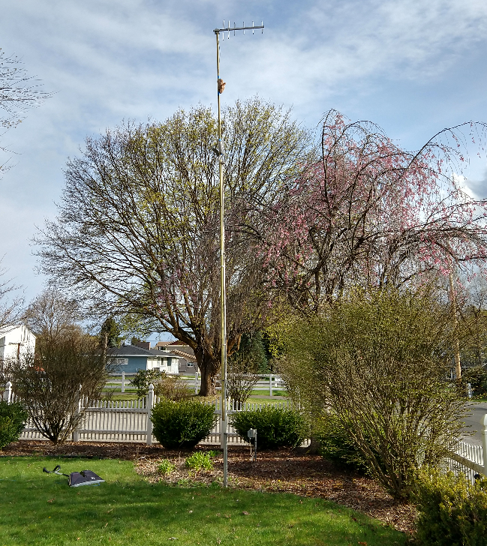
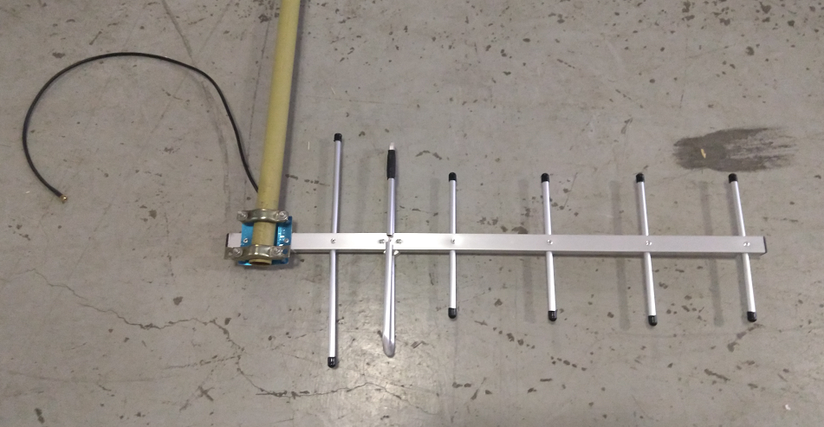
New Networking Problem – Antenna Mast
Mounted the antenna to the mast and then mounted to a flagpole

Slide 21
New Networking Problem – Antenna Mast
Zane’s side

Slide 22
Notes:
22

